Slide 1
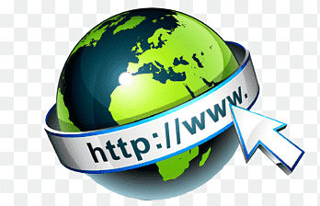
How the Web Works?
Dr. Muhammad Habib

Slide 2
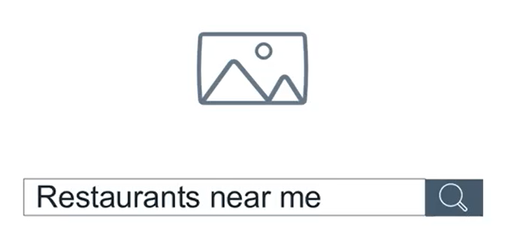
How the Internet Works?
Did you ever find yourself searching for something online?
How long does it take to get a response from your search?
You search for something and you get a response back in no time.
That's really something, isn't it?
But did you ever think about how it all happens?

Slide 3
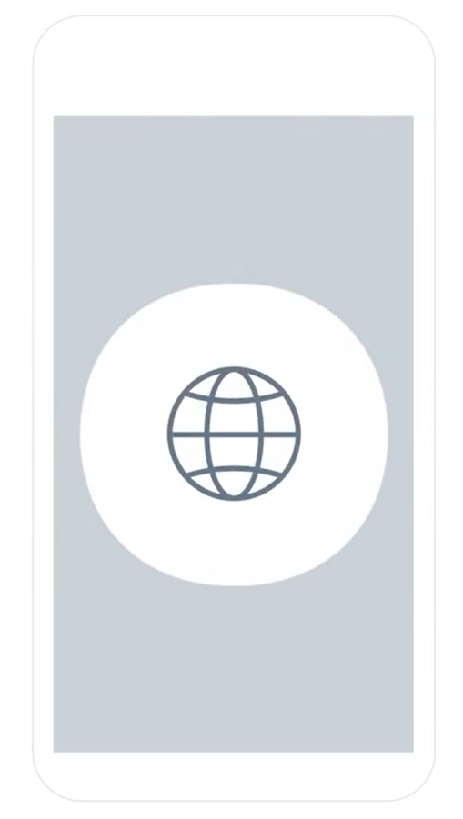
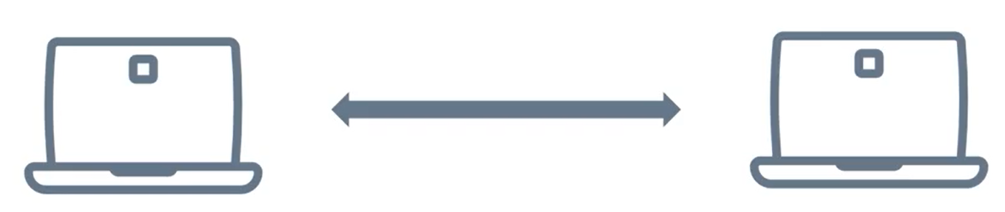
Network
Let's start at the beginning.
You open your favorite browser/app on your device and you're instantly connected to the world.
This is all made possible because two devices connect and communicate via a wired or wireless connection, forming something called a network.

Slide 4
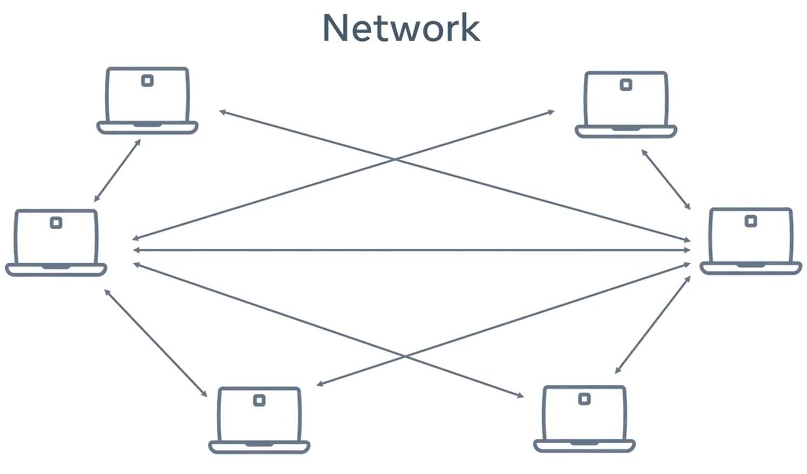
Network
You can connect multiple devices to this network.
But this becomes very complicated very quickly, as each device needs to connect to every other device to communicate effectively.

Slide 5
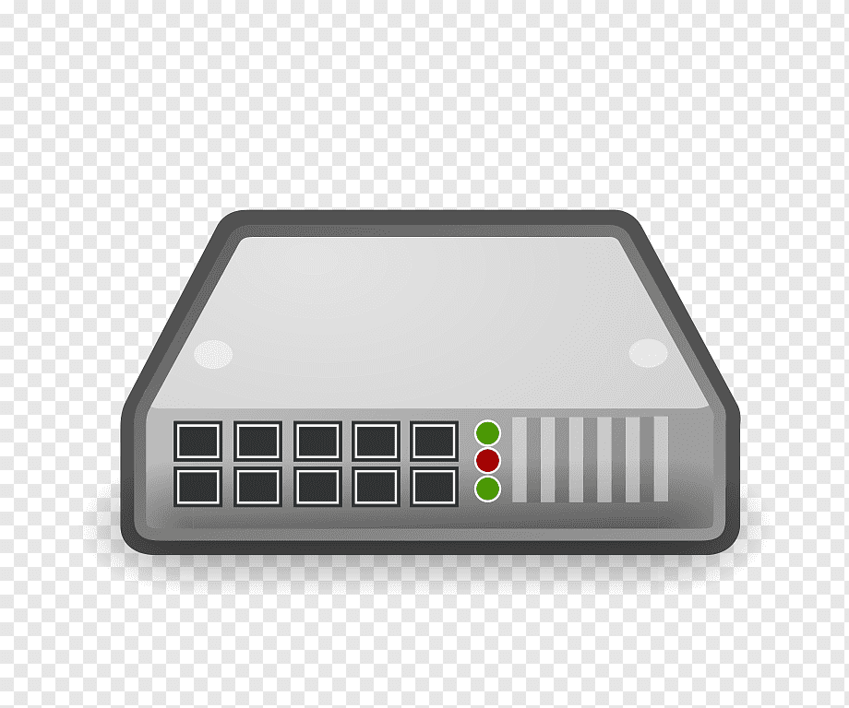
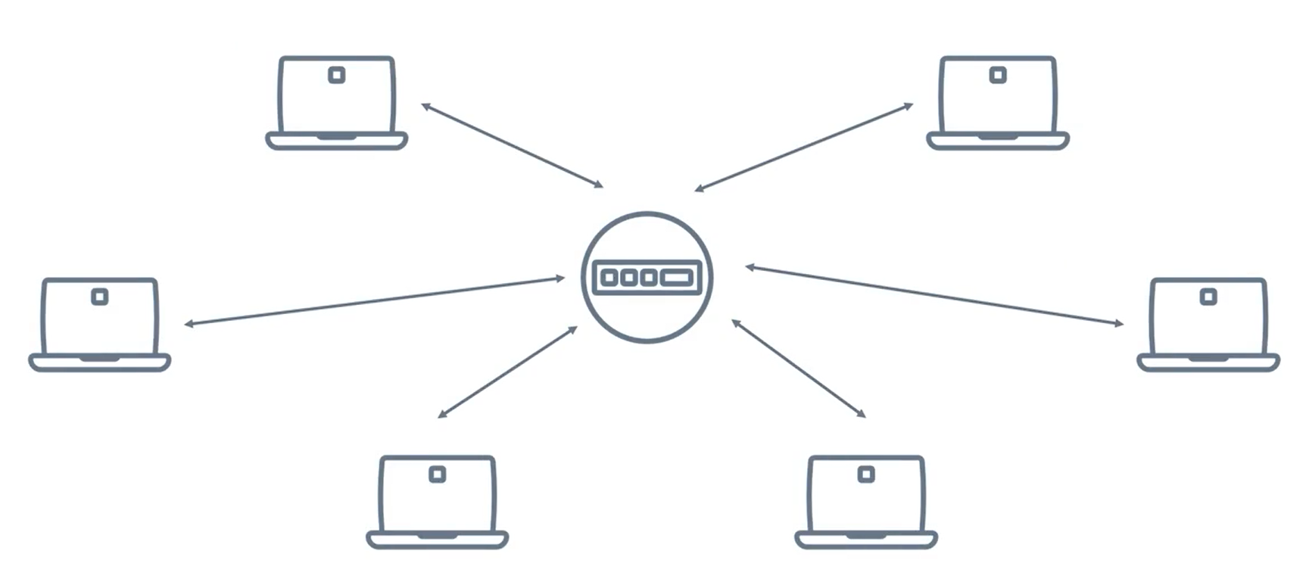
Network Switch
This problem is solved by something called a network switch that connects multiple devices and allows them to communicate with each other.

Slide 6
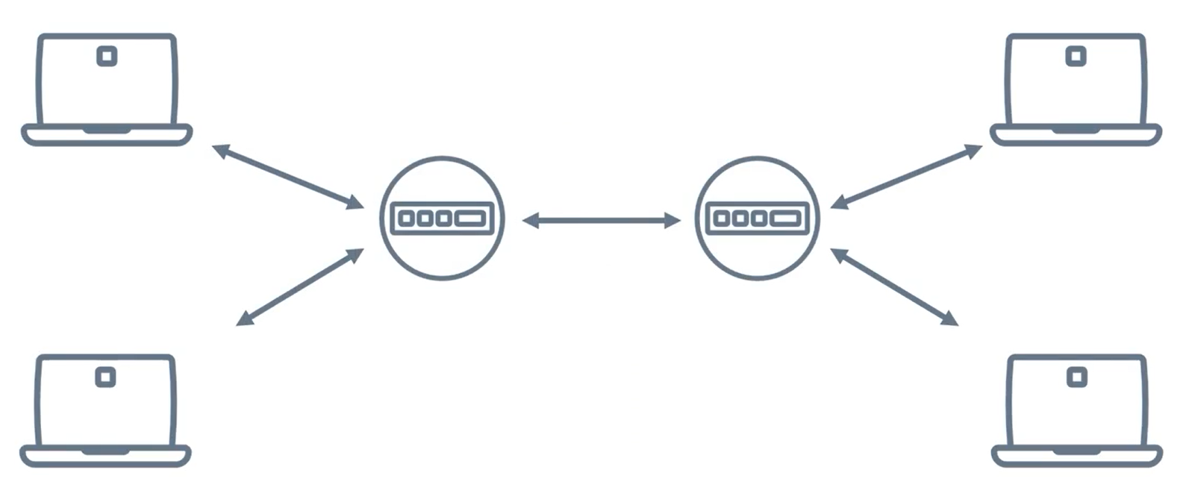
Network Switch
The network switch can connect to other network switches, and now two networks can connect.

Slide 7
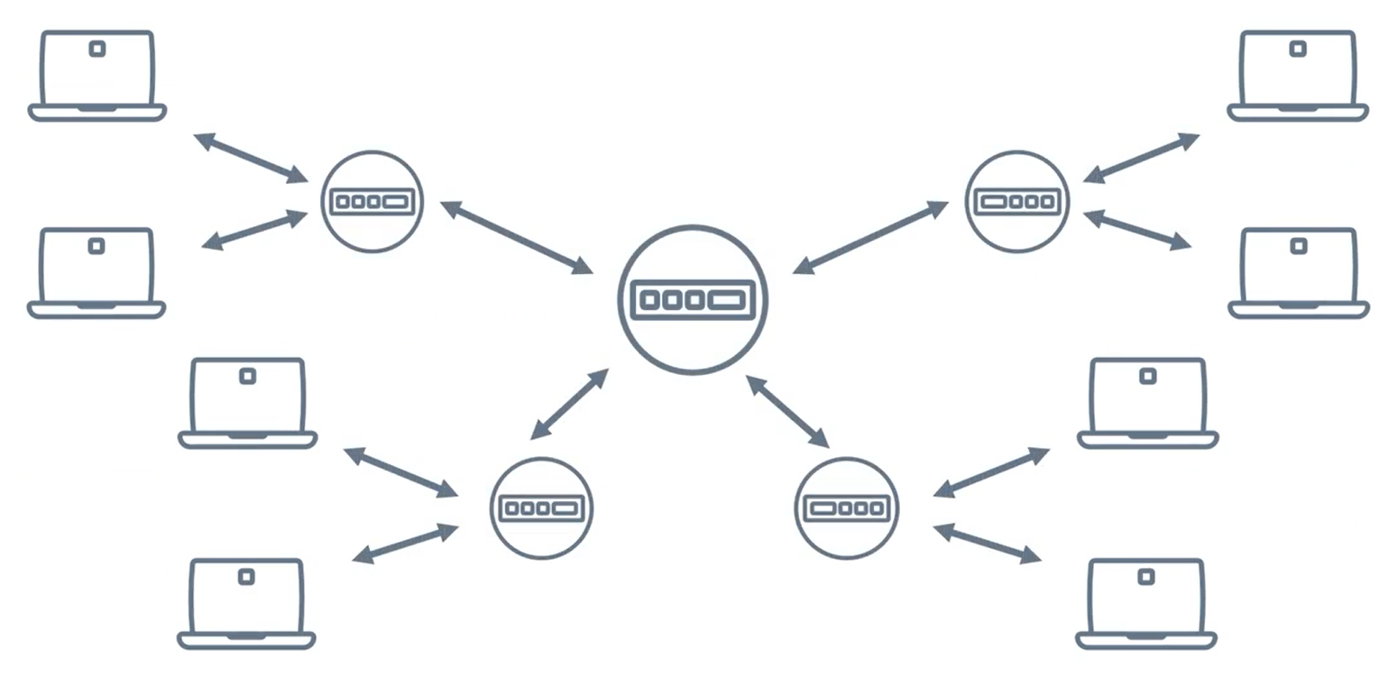
Interconnected Network
These network switches then connect to more network switches until you have something called an interconnected network.

Slide 8

The Internet
This interconnected network has another name that you might be familiar with.
It's called the Internet.

Slide 9
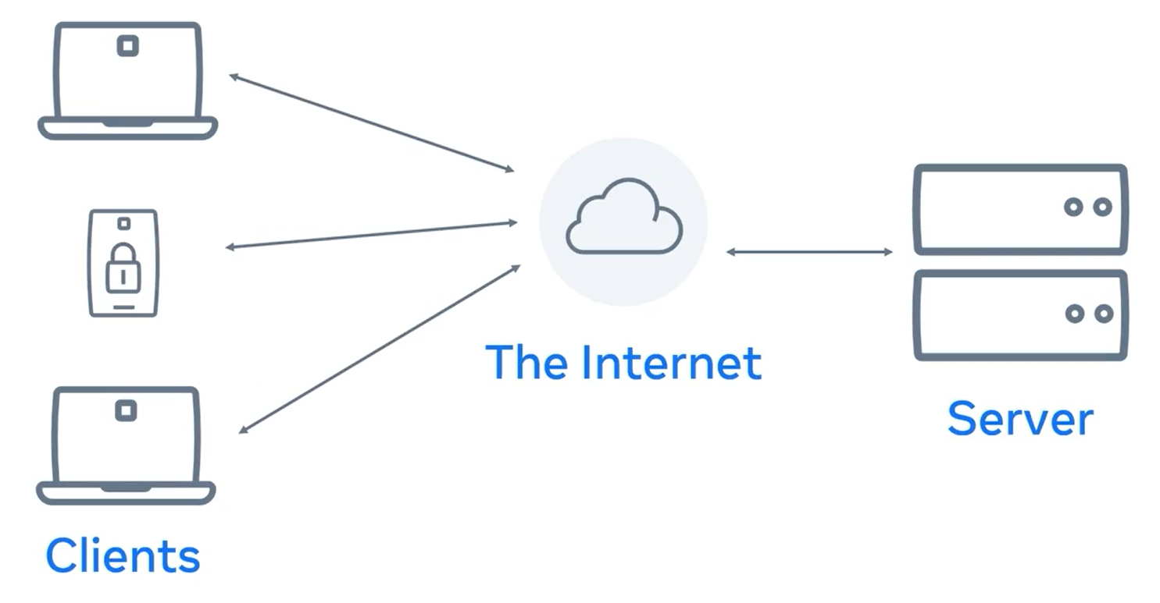
Client-Server Model
When we use websites or video streaming services on the Internet, these are provided by computers called servers.
Our devices are called clients. This is known as the client-server model.

Slide 10
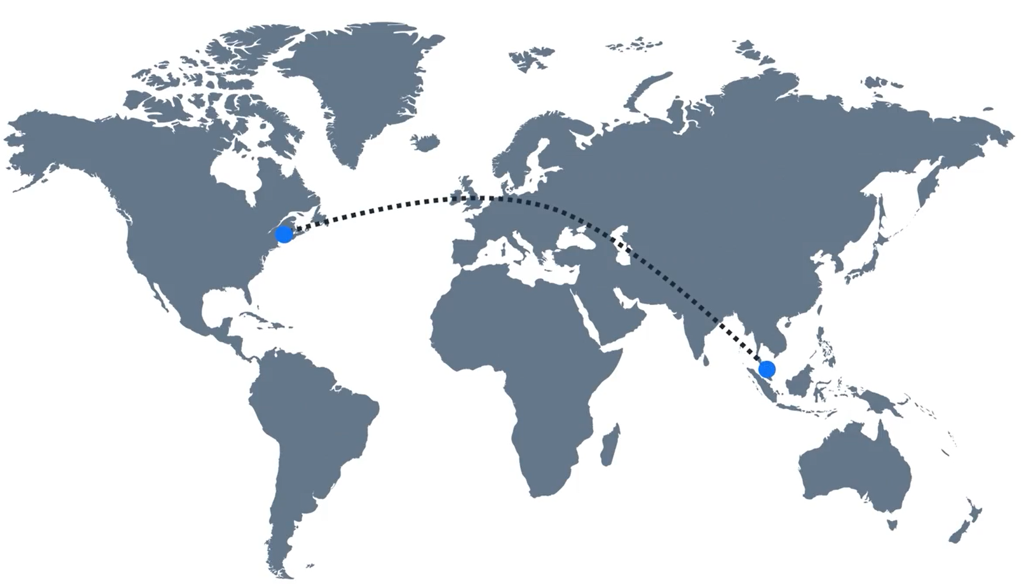
Internet connects the entire world

Slide 11
Internet connects the entire world
Internet connects the entire world.
Have you ever had a video call with someone on another continent?
That video data travel through large undersea cables connecting the world's networks.
These cables can transfer huge volumes of data per second.

Slide 12
Internet connects the entire world
There are a lot more technical details that go into making the Internet possible.
But this is the main idea.
Hopefully, this gave you the big picture of how the Internet works.

Slide 13
Additional Resources
Learn more Here is a list of resources that may be helpful as you continue your learning journey.
What is a Web Server? (NGINX)
https://www.nginx.com/resources/glossary/web-server/
What is a Web Browser? (Mozilla)
https://www.mozilla.org/en-US/firefox/browsers/what-is-a-browser/
Who invented the Internet? And why? (Kurzgesagt)
https://youtu.be/21eFwbb48sE
What is Cloud Computing? (Amazon)
https://youtu.be/mxT233EdY5c
Browser Engines (Wikipedia)
https://en.wikipedia.org/wiki/Browser_engine

Slide 14
Thank You

